Slide 1

What method of transport do pupils use to travel to school, and why?

Slide 2

Do different types of newspaper use words (or sentences) of different lengths? If so, why?

Slide 3

How does the climate of Britain compare with that of Greece?

Slide 4
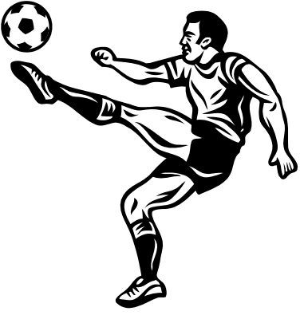
At what time of a football match is there most likely to be a goal?

Slide 5
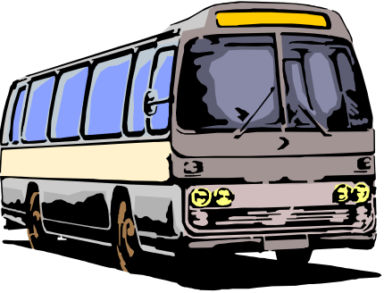
A neighbour tells you that the local bus service is not as good as it used to be. How could you find out if this is true?

Slide 6

How much TV do pupils and adults watch?

Slide 7

How do modes of transport to an out-of-town shopping centre compare with those to a town centre?

